Slide 1

Extempore: The Art of Spontaneous Speaking
Extempore, also known as impromptu speaking, is the art of delivering a speech without prior preparation. It involves thinking on your feet and presenting your thoughts in a coherent and engaging manner.

Slide 2

Importance of Extempore Skills:
Extempore skills are crucial in various aspects of life. They enhance communication, critical thinking, and adaptability.
1
Boost Confidence
2
Improve Thinking
Regularly practicing extempore speaking helps build confidence in public speaking.
The ability to quickly organize your thoughts and express them clearly is a valuable skill in personal and professional life.
3
Enhance Creativity
4
Expand Knowledge
Thinking on the spot encourages creativity as you explore different ideas and perspectives.
Exposure to diverse topics and perspectives through extempore helps expand knowledge and broaden horizons.

Slide 3

Preparing for an Extempore
While extempore involves speaking spontaneously, some preparation can enhance your performance.
1
Understanding the Topic
Gain basic understanding of the topic if provided in advance.
2
Thinking of Ideas
Think about relevant points, examples, and arguments.
3
Structuring your Speech
Organize your thoughts into an introduction, body, and conclusion.
4
Practice Delivery
Practice speaking aloud, focusing on clear articulation and engaging tone.

Slide 4
IT in Automobile :-
The automotive industry is undergoing a major transformation due to the integration of IT.
Advanced Driver-Assistance Systems (ADAS)
Connected Car Technologies
Electric Vehicle (EV) Technology
Connected car technologies enable communication between vehicles, infrastructure, and drivers, providing real-time information and enhancing road safety.
ADAS technologies like lane departure warning, adaptive cruise control, and automatic emergency braking use sensors and software to enhance safety and driver experience.
EVs utilize IT extensively in battery management systems, charging infrastructure, and advanced powertrain control.
Navigation and route optimization
Battery management and monitoring
Lane departure warning
Traffic updates and alerts
Charging infrastructure and management
Adaptive cruise control
Remote vehicle diagnostics
Automatic emergency braking
Electric powertrain control and optimization

Slide 5
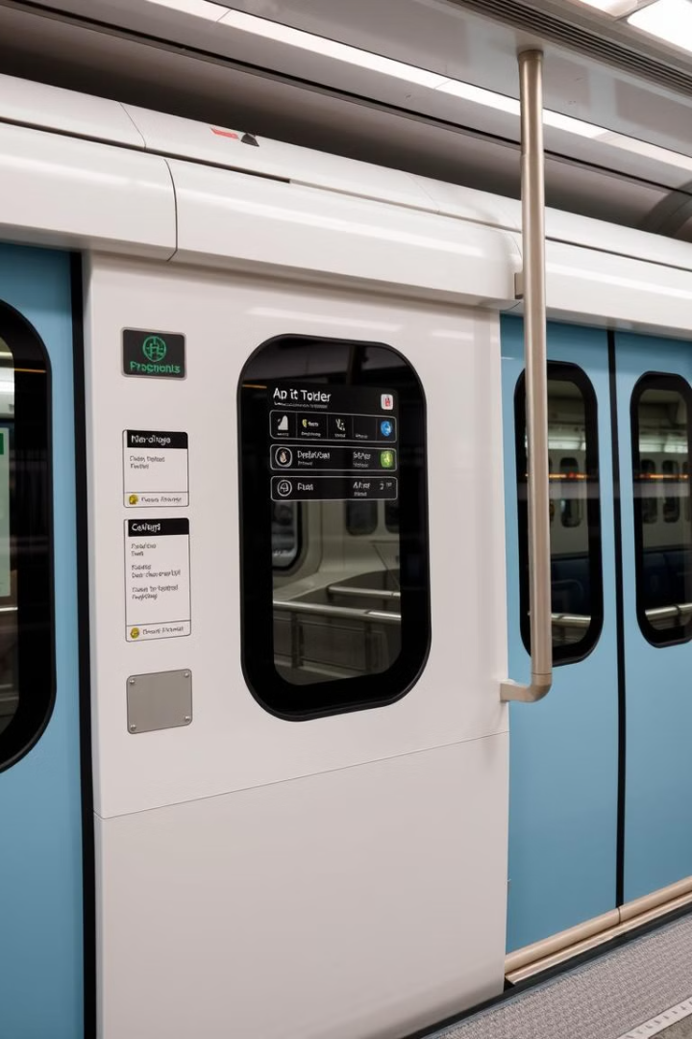




IT in Metro Rail :-
IT plays a crucial role in efficient and safe operation of metro rail systems.
Automated Train Control (ATC)
ATC systems control train movements, speed, and braking, enhancing safety and efficiency.
Passenger Information Systems (PIS)
PIS provide real-time information on train schedules, route maps, and station announcements.
Fares Collection Systems
Automated fare collection systems improve efficiency and accuracy, making it easier for passengers to travel.
Security Systems
Security systems utilize surveillance cameras, access control systems, and other technologies to ensure passenger safety.

Slide 6
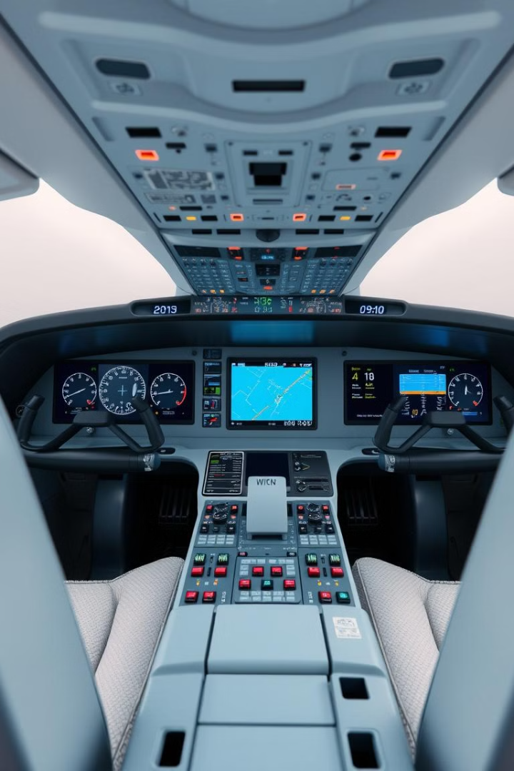
IT in Avionics :-
Avionics, the electronics and IT systems within aircraft, have revolutionized aviation.
Flight Management Systems (FMS)
Navigation, route planning, and performance optimization.
Electronic Flight Instrument System (EFIS)
Provides critical flight information to the pilots, replacing traditional analog instruments.
Automatic Flight Control System (AFCS)
Autopilot and stability augmentation systems enhance safety and efficiency.
Communication and Navigation Systems
Enable communication with air traffic control and other aircraft, and provide precise navigation information.

